Slide 1


DSA0305 - Natural Language Processing
CO1AT2 Technical Presentation
Title: Comparative Study of NLP Models and Algorithms
Guided By
Dr. K. Anbazhagan
By Syed Muhafiz A
192472282

Slide 2
FOUNDATIONS
Why Architecture Matters in NLP
Not all NLP models are built the same — the architecture determines what a model can learn, how fast it trains, and which tasks it excels at.
Each of the three dominant architecture families emerged
to solve the limitations of its predecessor. Choosing the
right model means better results with fewer resources.
CNNs
Efficient local pattern recognition — adapted from image processing to text
Transformers
RNNs / LSTMs / GRUs
Parallel attention-based processing — the current state of the art
Sequential processing with memory — built for language's inherent order

Slide 3
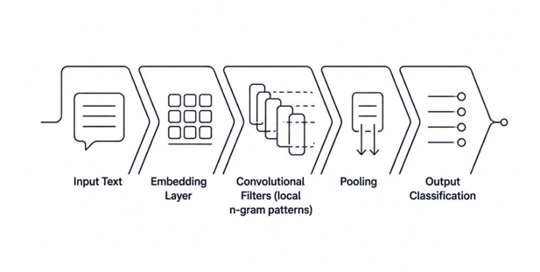
ARCHITECTURE FAMILY 1
Convolutional Neural Networks (CNNs)
How They Work
Strengths
Originally designed for images — adapted for text by sliding filters over word sequences to detect local patterns
Captures local patterns (n-grams) very efficiently with fast training and low memory usage
Best For
Limitation
Text classification, spam detection, sentiment analysis
Ignores word order beyond local windows; poor at long-range dependencies

Slide 4

ARCHITECTURE FAMILY 2
Recurrent Neural Networks (RNNs)
Simple RNN
LSTM
GRU
RNNs process text sequentially — each word is informed by all previous words. Simple RNNs pass the previous output as input to the current step. LSTMs extend this with gating mechanisms that solve the vanishing gradient problem, enabling much longer memory. GRUs offer a simplified architecture that is often faster to train while achieving comparable performance. These models excel at language modeling, named entity recognition, and speech recognition — but are slow to train and struggle with very long sequences.

Slide 5

ARCHITECTURE FAMILY 3
Transformers: The Game Changer
BERT
"Attention Is All You Need" — Vaswani et al., 2017
Bidirectional encoder — excels at language understanding tasks
Transformers revolutionized NLP by processing all words in a sequence in parallel using self-attention mechanisms, rather than one word at a time like RNNs.
Research has shown that a one-layer Transformer of logarithmic width can perform index lookup tasks where an RNN requires a hidden state of linear size — a fundamental efficiency advantage.
GPT
Autoregressive decoder — state of the art for text generation
T5
Transformers win on quality; CNNs/RNNs win on efficiency — keep this tradeoff in mind.
Text-to-text framework — unifies all NLP tasks in one model
Limitation: Computationally expensive; requires large datasets to shine.

Slide 6
Head-to-Head: Architecture Comparison
A direct side-by-side look at how the three architecture families compare across the dimensions that matter most for students choosing a model.
Architecture
Parallelizable
Long-range Context
Training Speed
Memory Use
CNN
Yes
Limited
Fast
Low
RNN / LSTM
No
Moderate
Slow
Medium
Transformer
Yes
Excellent
Moderate
High

Slide 7
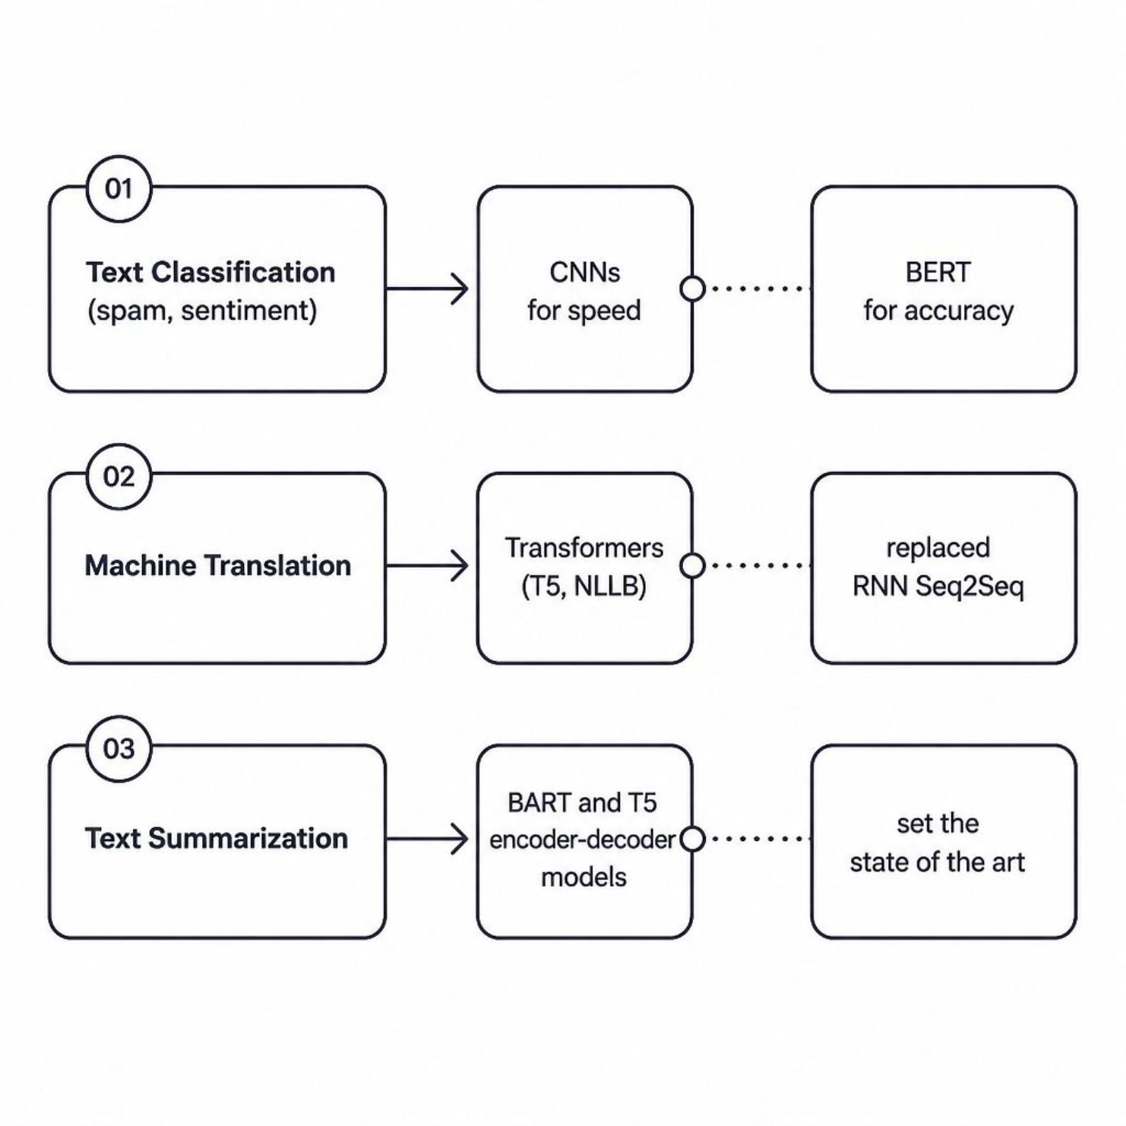
Use Cases: Which Model for Which Task?
1
Text Classification
Spam detection and sentiment analysis: CNNs and fine-tuned BERT both excel. BERT leads on accuracy, CNNs win on speed. Research confirms this tradeoff across sentiment, question-answering, and classification benchmarks.
2
Machine Translation
Transformers (Google's T5, Meta's NLLB) now dominate — they have fully replaced the older RNN-based Seq2Seq architectures that once defined the field.
3
Text Summarization
Transformer encoder-decoder models like BART and T5 set the current state of the art for both extractive and abstractive summarization.

Slide 8




Choosing the Right Model: A Student's Guide
Use this decision framework when starting a new NLP project.
Limited Compute
Sequence + Context
Best Accuracy
Start with a CNN or GRU — lightweight, fast to train, ideal for quick prototypes
Use LSTM / GRU for moderate-length sequences where word order and memory matter
Fine-tune a pre-trained Transformer (BERT, GPT) — transfer learning saves enormous training time
Rule of thumb: Transformers win on quality; CNNs and RNNs win on efficiency. Match your model to your constraints, not just your ambitions.

